Slide 1
8th August 2017
Rules for avoidance system
Prague, Czechia
Alojz Gomola, Advanced Technology Europe

Slide 2
Content
Introduction
Airspace segmentation
Expected mission types and constraints
Surveillance and reconnaissance tasks (Civil/Military)
Low altitude flight (Civil/Military)
Package delivery (Civil/Military)
Constraints and rules in non segregated air space
ICAO and manned aviation viewpoint on UAV/RPAS systems
Expected minimal behavior definition
Air Traffic Management constraints
Weather avoidance constraints
Rules of the Air
Avoidance priority

Slide 3

Introduction

Slide 4
Airspace classification
Space is separated into levels defined by boundaries:
Level C-F – altitude in Flight Levels (FL)
Level G – altitude in feet Above Ground Level (AGL)

Slide 5
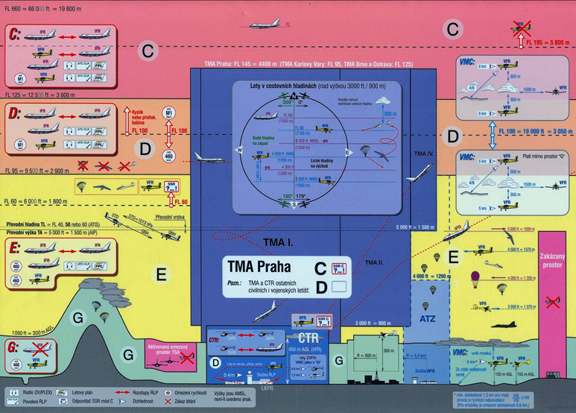
Airspace classification
Space is separated into levels defined by boundaries:
Level C-F – altitude in Flight Levels (FL)
Level G – altitude in feet Above Ground Level (AGL)
Example of European Airspace classification
(Czech republic)
Next slide

Slide 6
Airspace classification (Detail)

Slide 7
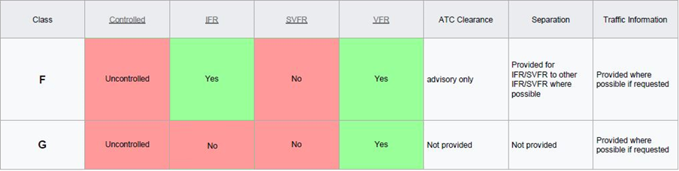
Airspace levels for UAV operations
ICAO airspace classification:
Class F(E): Operations may be conducted under IFR or VFR. ATC separation will be provided, so far as practical, to aircraft operating under IFR. Traffic Information may be given as far as is practical in respect of other flights.
Class G: Operations may be conducted only under VFR. ATC has no authority but VFR minimums are to be known by pilots. Traffic Information may be given as far as is practical in respect of other flights.

Slide 8

Expected mission types and constraints

Slide 9
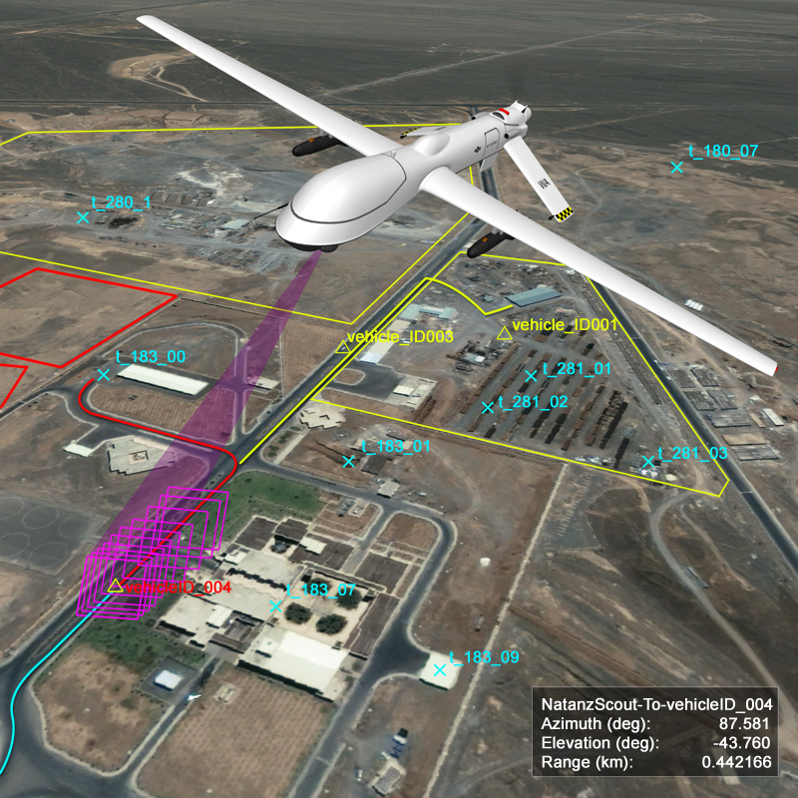
Surveillance and reconnaissance tasks
Goals:
Cover most of the area
Stay safe
Long term plan:
Generate surveillance plan (Fotios Balampanis USE)
Short term avoidance:
Avoid intermediate obstacles
Maintain maximal scanning height

Slide 10
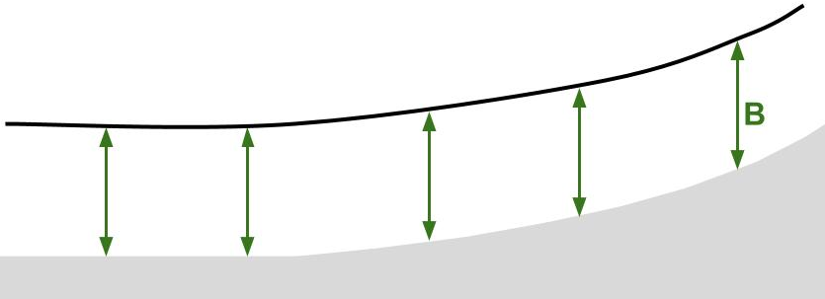
Low altitude flight
Long term goals:
Follow terrain within given altitude B
Avoid detection from adversary
Rules:
Prioritize trajectory leading closest to the ground

Slide 11
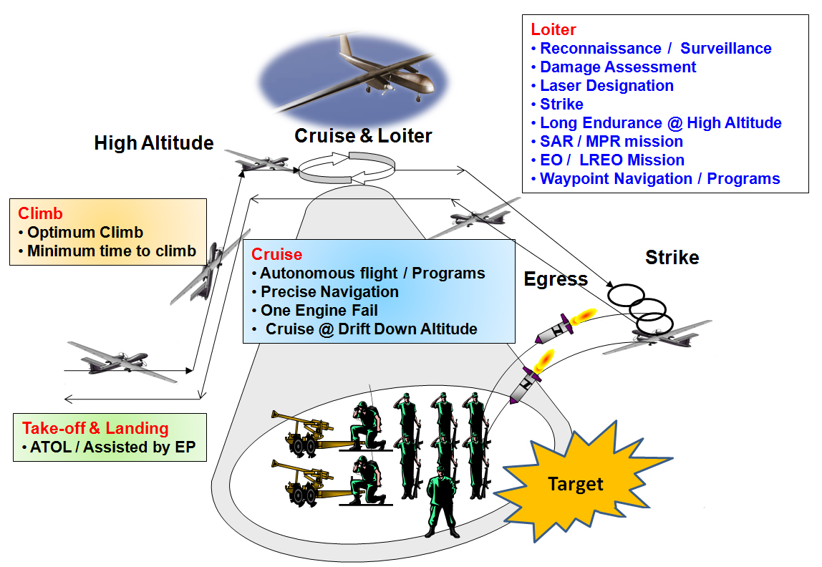
Package delivery

Slide 12

Constraints and rules in non-segregated air space

Slide 13
Airspace level constraints
Traffic in G level of airspace
There is possible traffic occurrence under 500 feet AGL
Manned aviation is often executing rescue service or emergency maneuvers
Portions of G level of airspace can be occupied by restricted fly zones, especially in case of airport surroundings or military exercises.
The exceptions for manned operations are given by local flight authority and they are bounded to some altitude levels defined from AMSL
Traffic in F(E) level of airspace
There is expected traffic occurrence over 500 feet AGL to 10k feet AMSL, there is also possibility to encounter larger manned aircrafts due the flight pathways intersections
All previous constraints applies

Slide 14
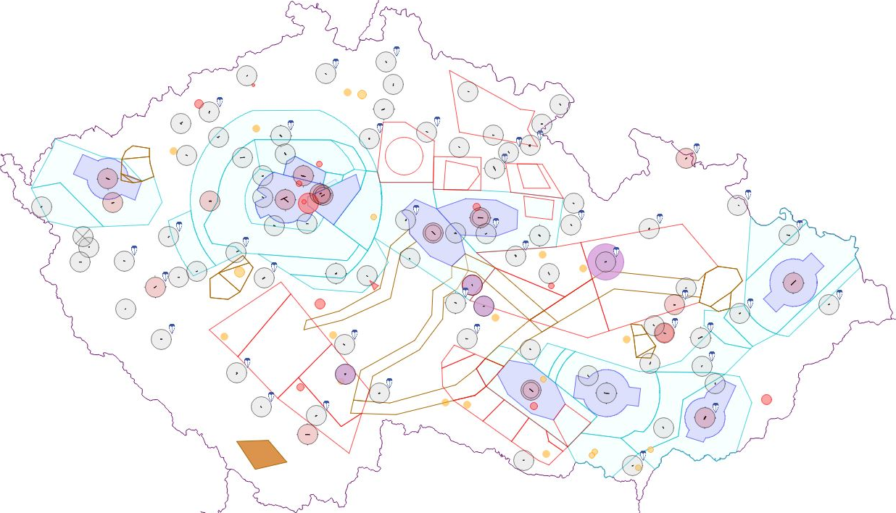
Example of air traffic constraints
Example of air traffic constraints is taken from Czech national air traffic control portal (http://aisview.rlp.cz/)
Airport
Control zone
Temporary area

Slide 15
Traffic constraints
Airport control zone
Restrictions defined with reference pressure at airport (AMSL)
To execute maneuvers in airport area the rules for B/C level zones applies
Defined as static zones
Starts at 0 feet AGL
Open air control zone
Restrictions defined with reference pressure (AMSL)
Reference pressure is given by local meteorological authority
Temporary restricted areas
Same reference conditions as Open Air Control zone
Temporary restricted areas starts usually in E class airspaces
Reference altitude is usually set above small UAV operational level
Temporary restricted areas must be avoided by any air traffic manned or unmanned
High violation fees are enrolled in case of any restriction breech

Slide 16
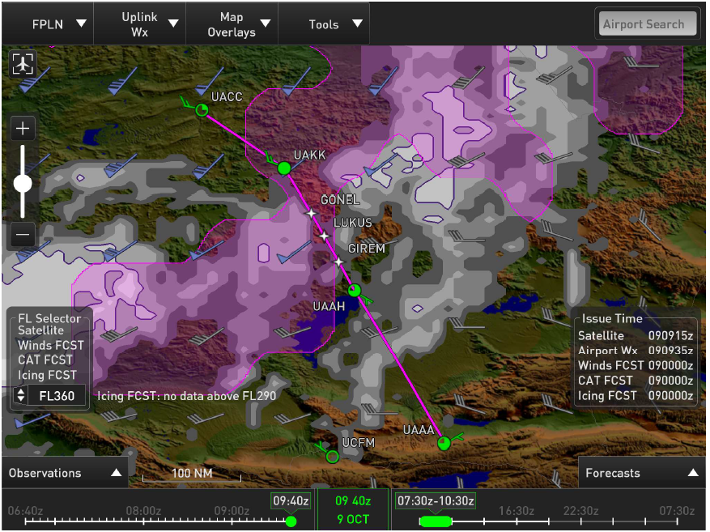
Weather constraints
UAV system in general is more sensitive to weather conditions than standard manned aviation (icing, storms, turbulences)
Clouds can generally render UAV sensing system
Especially thick fog renders LiDAR sensor range tremendously
Modern manned aviation system can provide data necessary for weather situation avoidance
Example of advanced weather warning system developed by Honeywell.
Extracted data can be used as a source of restrictions for UAV

Slide 17
Manned aviation constraints summary
UAV must avoid all manned aviation at all costs, pilot usually does not have a chance to detect the unmanned vehicle of very small scale. There is no will to change the manned aviation regulations, therefore autonomous vehicles must adapt to this situation.
There was an effort to enforce ADS-B transmitter on every manned aviation vehicle, but it was refused by ICAO and other organizations.
UAV must implement following, to be successfully integrated into non-segregated airspace:
Consider every manned aviation vehicle as blind adversary
Respect ICAO zonation of airspace and stay in F(E),G levels open for free flight
Respect altitude constraints based on atmospheric pressure valid for region of operation (AMSL from airport/local authority)
Respect weather conditions

Slide 18
Manned aviation constraints impact on UAV
Constraints map, reference atmospheric pressure and weather map is updated on hourly basis, therefore actual data from authorities must be considered by UAV (short term operations can be executed without established communication link)
Outline of rules identified from short analysis are like follow:
UAV must consider airspace and weather space constraints as virtual obstacles with very high avoidance priority
UAV must consider atmospheric pressure or have very precise altitude (AMSL and AGL) approximation
UAV must consider every manned aviation vehicle as adversary vehicle
These rules can be reflected in long term planning and waypoint selection to dynamically append mission plan according to situation.

Slide 19
Intruder avoidance priority
Our vision is based on various projects:
Amazon Drone platform – fully autonomous UAV
NASA – UTM (UAV Traffic Management) – rules in development
JARUS – SAA regulation framework (in development)
The rules of the air are formulated (ICAO annex II.) around avoidance priority, depending on technical capabilities of manned aircraft type (Jumbo jet should avoid glider due higher maneuverability).
The expected behavior of UAV platform is given by following table:
Intruder | Our vehicle | Priority
Manned aircraft | Any UAV | Manned aircraft
VLOS piloted UAV | VLOS piloted UAV | Coordinated avoidance
VLOS piloted UAV | Autonomous UAV | Autonomous UAV
Autonomous UAV | Autonomous UAV | Coordinated avoidance

Slide 20
Rules of the air – “Right of the way”

Slide 21
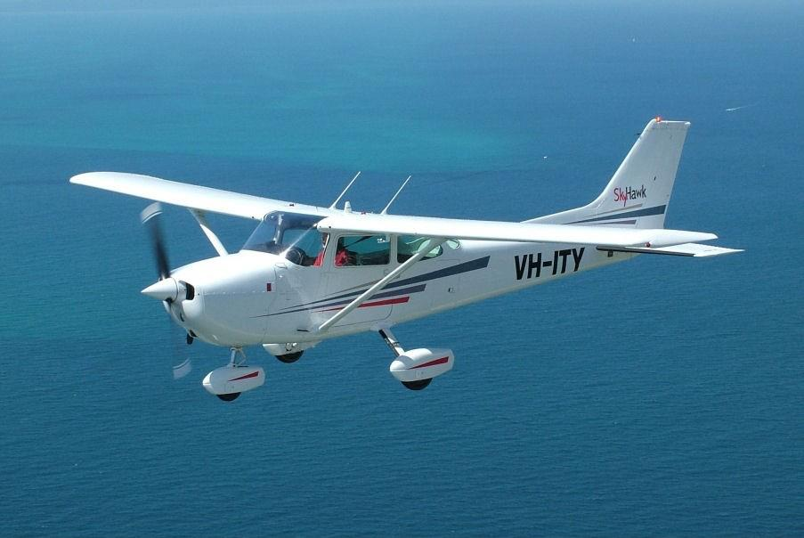

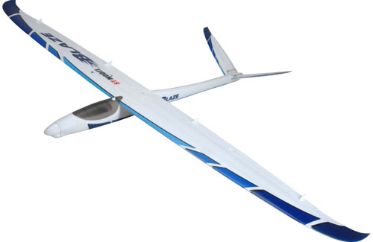
Aviation classes for immediate avoidance
FIRST: Manned aviation in distress
SECOND Balloons THIRD Gliders
Mayday, mayday, mayday!

Slide 22
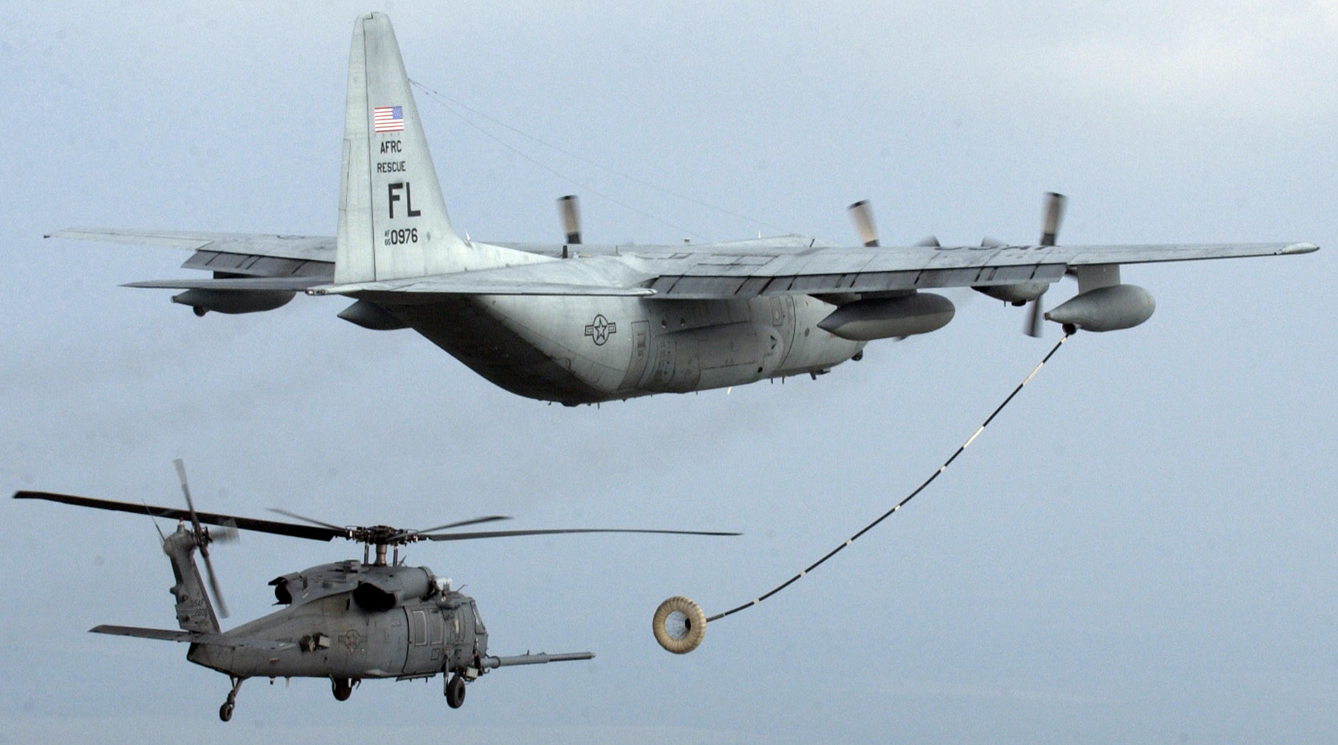
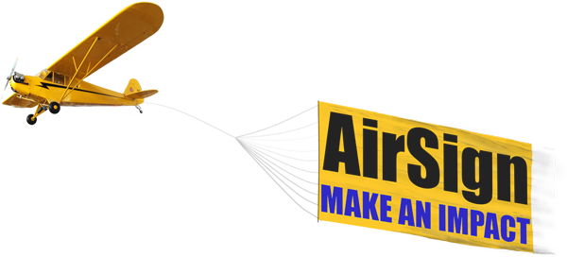
Aviation classes for immediate avoidance
FOURTH: Aerial fueling and towing
Fueling of aircraft
Towing a sign, aircraft or other dependable load

Slide 23
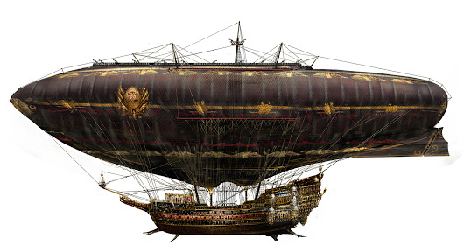
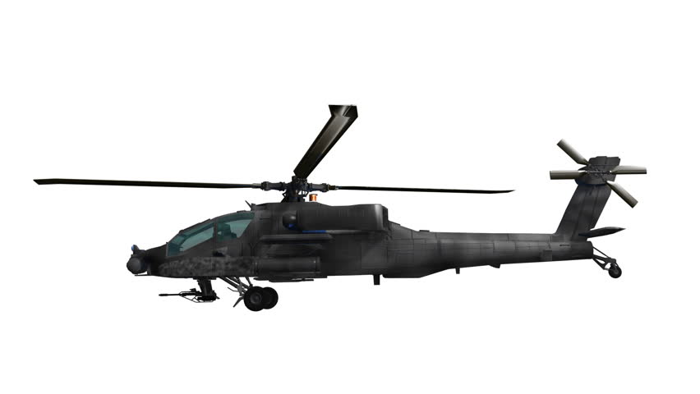
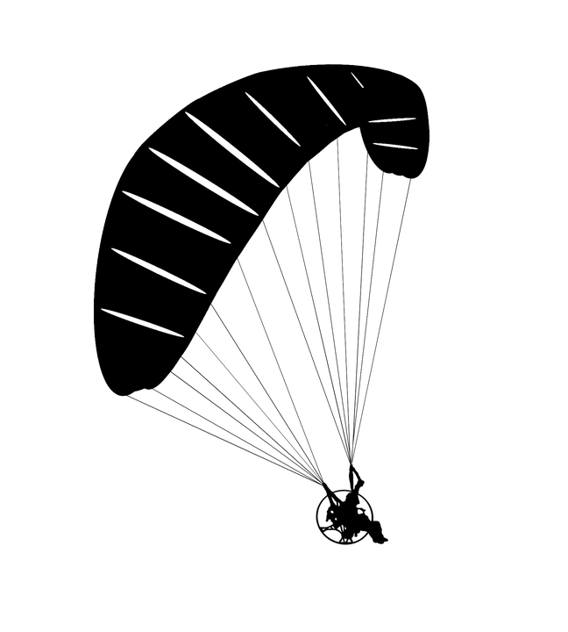
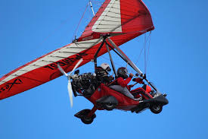
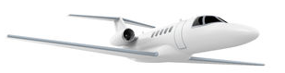
Aviation classes for immediate avoidance
FIFTH: Airships
Sixth: Manned aviation with propeller

Slide 24
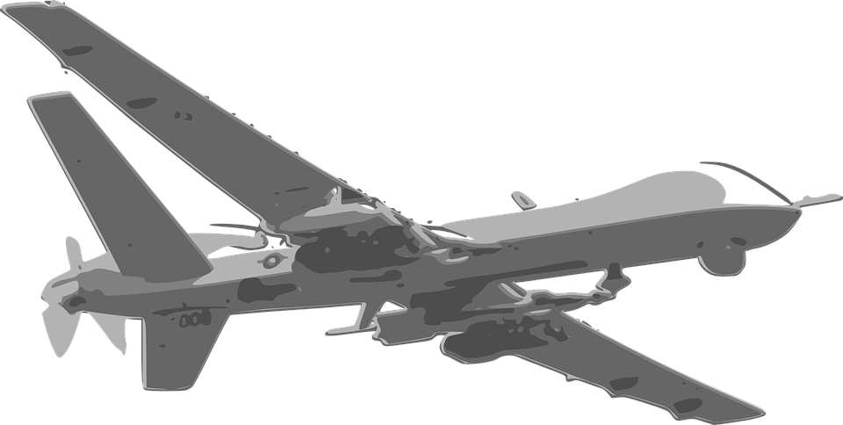
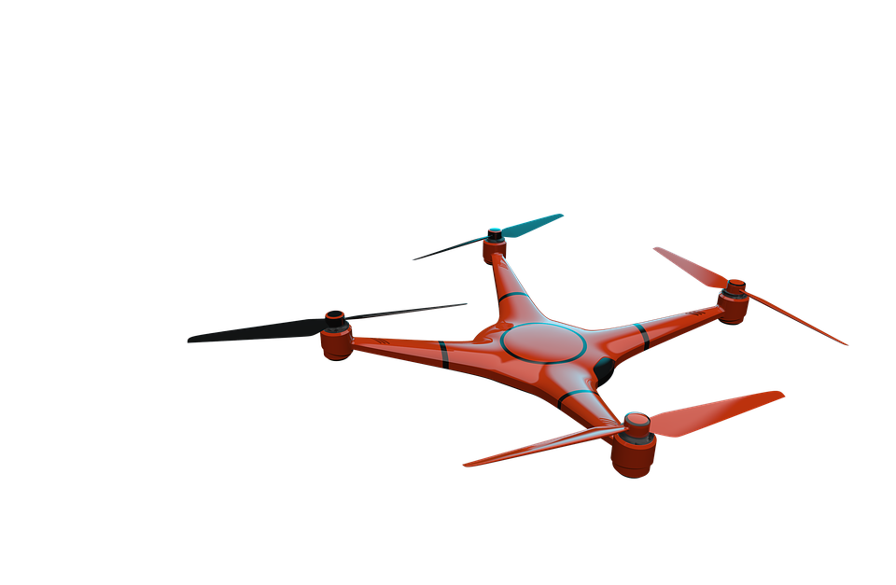
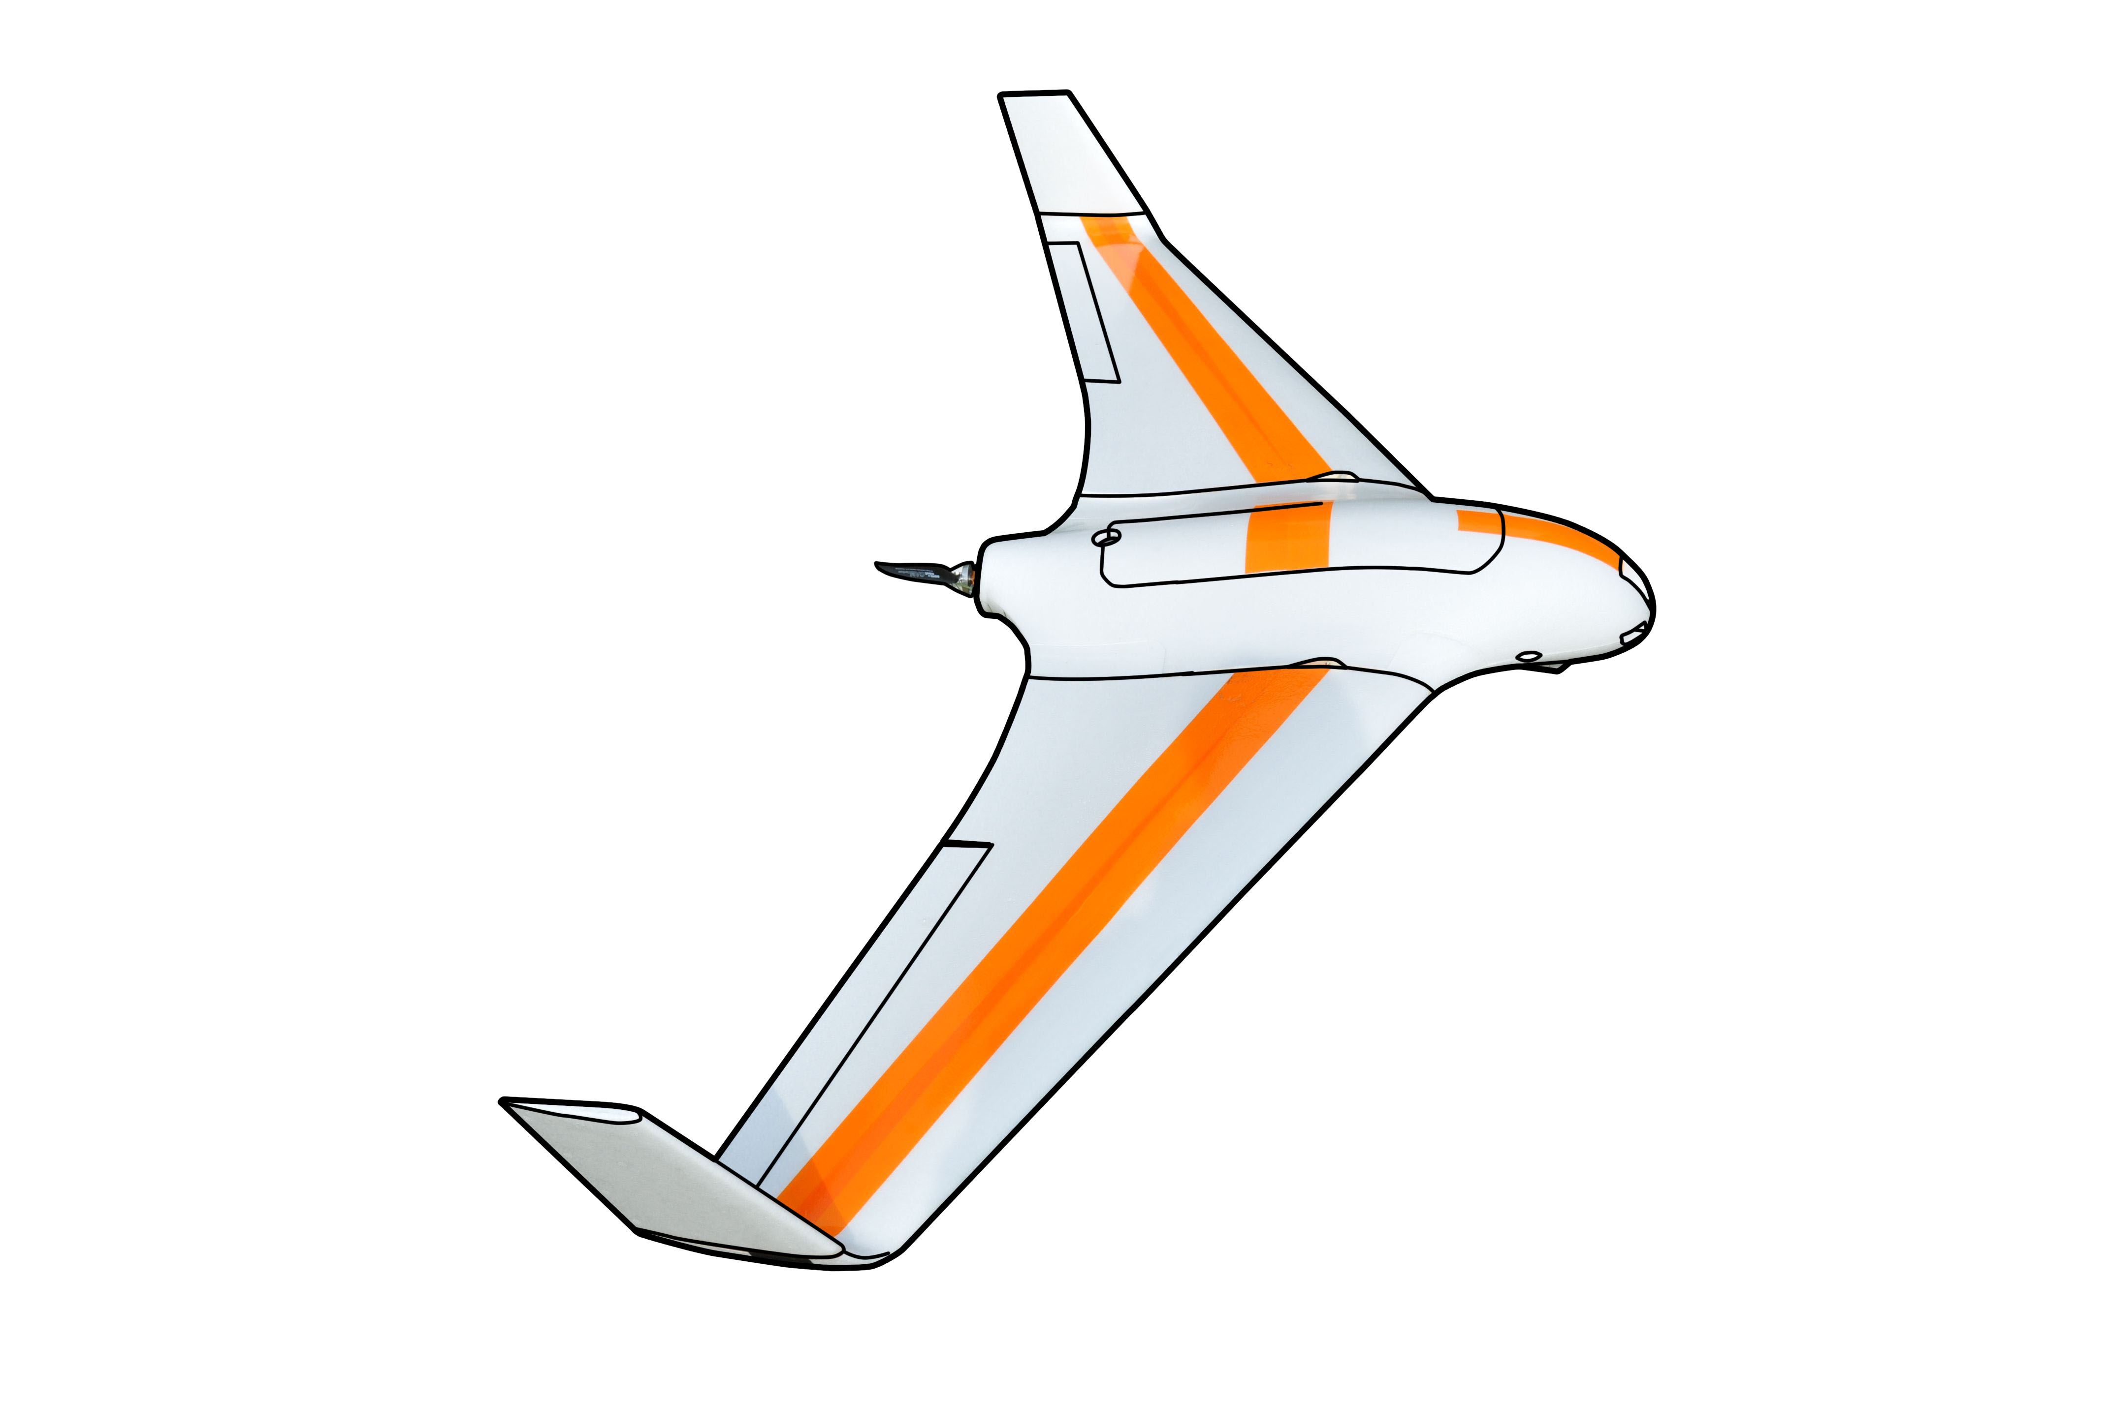
Proposed unmanned aviation classes
Seventh: Unmanned aviation with standardized avoidance system
Eighth: Unmanned aviation for VLOS operations piloted from ground

Slide 25
Right of the way rules
Right of the way rules aid pilots in avoiding each other visually
The rules are found:
Part 91 Federal Aviation Regulation (USA)
ICAO Annex 2 -> Chapter 3 - General Rules -> 3.2 Avoidance of collisions -> 3.2.2 Right of way (International)
When aircrafts are converging, the right of way is generally given to the least maneuverable aircraft (higher class)
The aircraft now having the right of the way is to pass well clear of the aircraft having the right of the way
Application for rules of the air in case of UAV seems to be reduced to immediate avoidance in case of manned aviation
The avoidance rules can be applied between the same class of UAV

Slide 26

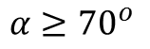
Converging aircrafts of the same category
$$α≥{70}^{o}$$
The aircraft on other right, hast the right of the way

Slide 27
Converging aircrafts of the same category

Slide 28
Converging aircrafts of the same category
The aircraft on other right, hast the right of the way
Turn right and stay away from approaching aircraft

Slide 29
Converging aircrafts of the same category
Return to original path behind other aircraft

Slide 30
Overtaking aircraft of the same category
Lower speed aircraft is being overtaken

Slide 31
Overtaking aircraft of the same category
The aircraft being overtaken has the right of the way

Slide 32
Overtaking aircraft of the same category
Overtake is executed from right

Slide 33

Overtaking aircraft of the same category
Overtake rule apply also for convergence under ${α<70}^{o}$

Slide 34
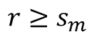
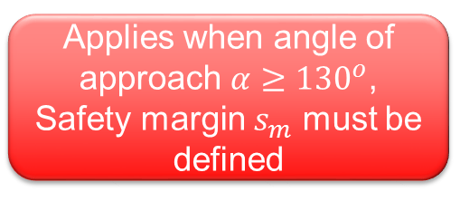
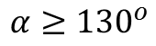
Head on approach of same category
$$α≥{130}^{o}$$
$$r≥s_{m}$$
Applies when angle of approach $α≥{130}^{o}$, Safety margin $s_{m}$ must be defined

Slide 35
Head on approach of same category
Both vehicles are taking right side avoidance

Slide 36

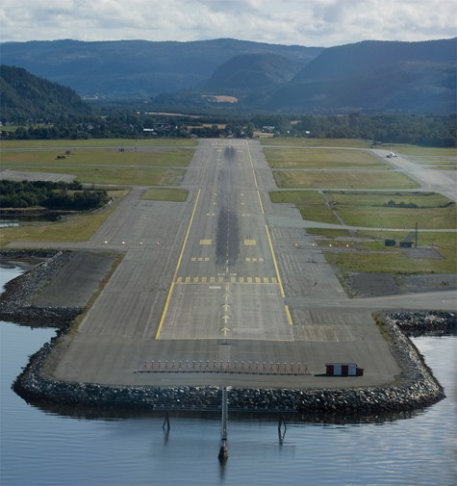
Approaching a runway of same category
Both aircrafts are trying to approach runway, to take landing sequence

Slide 37
Approaching a runway of same category
Aircraft altitude is determining factor in terms of “right of way”

Slide 38

Approaching a runway of same category
Lower aircraft has the right of the way

Slide 39
Approaching a runway of same category
Upper aircraft needs to wait for all other aircrafts to land

Slide 40
Approaching a runway of same category
When path is free other aircraft can land

Slide 41
Approaching a runway of same category
Both aircrafts have landed sucessfully

Slide 42
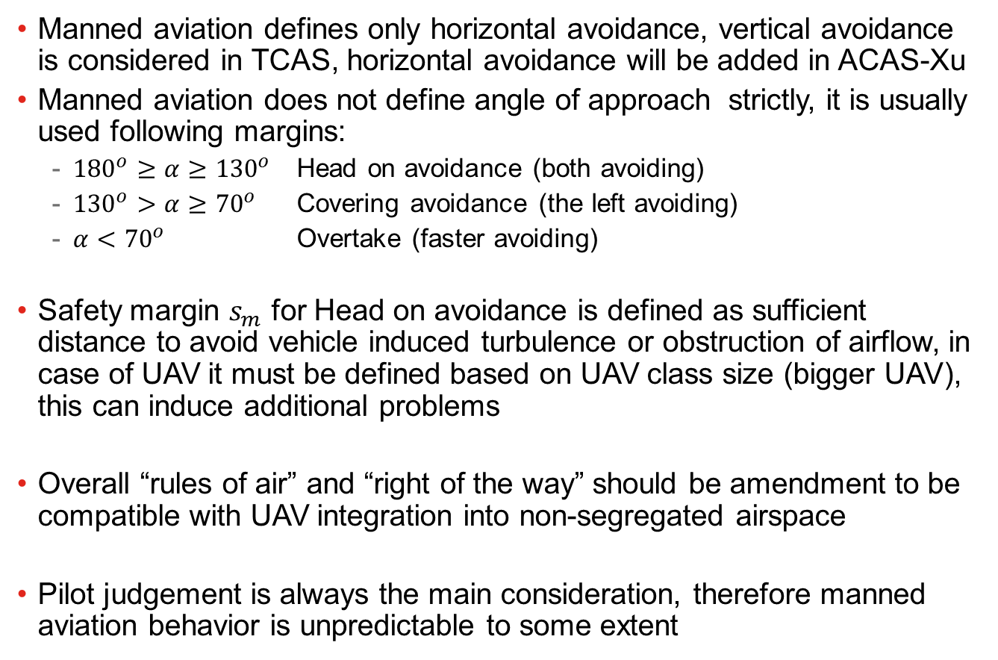
Summary - Right of the way
Manned aviation defines only horizontal avoidance, vertical avoidance is considered in TCAS, horizontal avoidance will be added in ACAS-Xu
Manned aviation does not define angle of approach strictly, it is usually used following margins:
${180}^{o}≥α≥{130}^{o}$ Head on avoidance (both avoiding)
${130}^{o}>α≥{70}^{o}$ Covering avoidance (the left avoiding)
$α<{70}^{o}$ Overtake (faster avoiding)
Safety margin $s_{m}$ for Head on avoidance is defined as sufficient distance to avoid vehicle induced turbulence or obstruction of airflow, in case of UAV it must be defined based on UAV class size (bigger UAV), this can induce additional problems
Overall “rules of air” and “right of the way” should be amendment to be compatible with UAV integration into non-segregated airspace
Pilot judgement is always the main consideration, therefore manned aviation behavior is unpredictable to some extent

Slide 43
ACAS-Xu (Next generation safety framework)

Slide 44
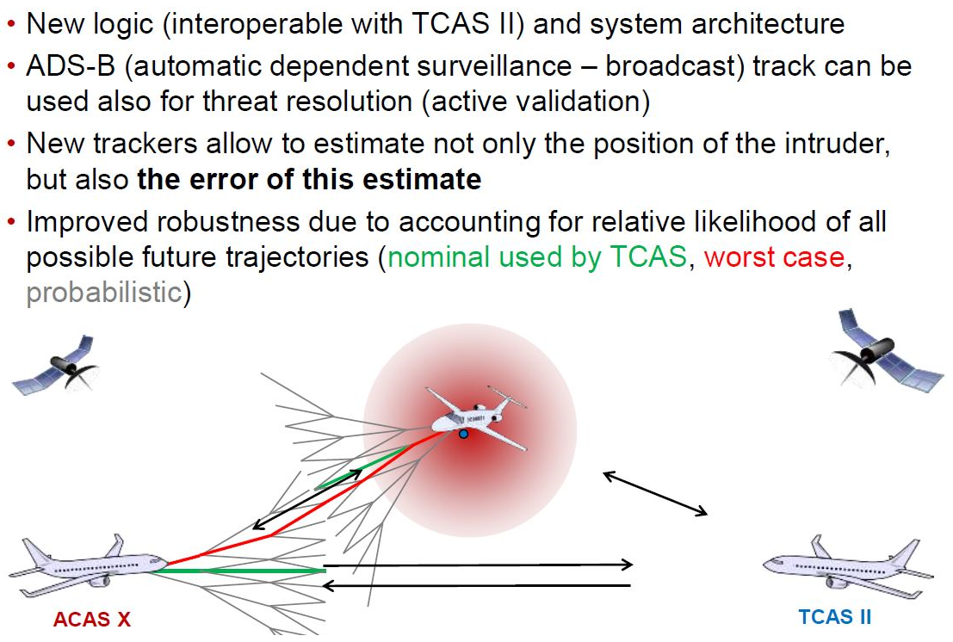
What is ACAS-X

Slide 45
ACAS $X_{A}$ vs. ACAS $X_{U}$
$$\text{RTCA}\text{, }\text{SC}\text{−147, }\text{ACAS} \text{Xu} \text{WG} \text{Kick}\text{−}\text{off}\text{, }\text{January}\text{ 12, 2016}$$

Slide 46
ACAS $X_{A}$ vs. ACAS $X_{U}$
$$\text{RTCA}\text{, }\text{SC}\text{−147, }\text{ACAS} \text{Xu} \text{WG} \text{Kick}\text{−}\text{off}\text{, }\text{January}\text{ 12, 2016}$$

Slide 47
ACAS $X_{A}$ vs. ACAS $X_{U}$
$$\text{RTCA}\text{, }\text{SC}\text{−147, }\text{ACAS} \text{Xu} \text{WG} \text{Kick}\text{−}\text{off}\text{, }\text{January}\text{ 12, 2016}$$

Slide 48
Automatic response downfall
Depending on the communication link, it is expected that there may be significant latency associated with RA data transmission to a ground-based flight crew and subsequent pilot aircraft control commands back to the aircraft in response to the RA
Loss of uplink or downlink communications with the UAS would entirely prevent ground-controlled collision avoidance, and may also degrade collision avoidance effectiveness on other aircraft in coordinated encounters
UAS may also lack additional outside information, such as visual identification of intruders, which allows pilots in manned aircraft to make real-time decisions regarding RA response.
The pilot has the ability to override auto-response at any time before or after the aircraft has started maneuvering

Slide 49
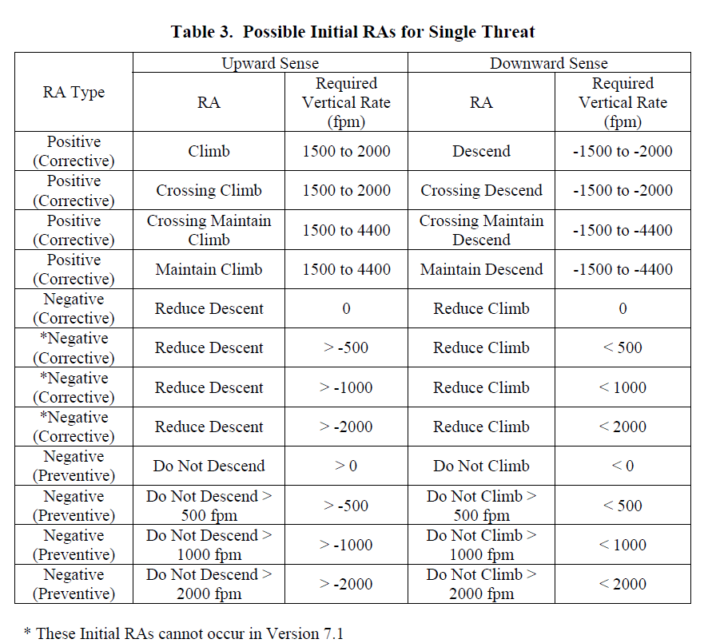
TCAS/ACAS RA advisories (!Horizontal only!)

Slide 50
ACAS Xu Summary
Safety – weather avoidance, mid air collisions
Strategic layer – flight planning (Hours/10^{ths} of minutes) [Mission plan]
Tactical layer – separation (10^{ths} of minutes/minutes) [Other systems]
Emergency layer – Collision avoidance (10^{ths} of seconds/seconds) (ACAS)
ACAS X merits to TCAS II limitations
Reducing nuisance alert rate while improving safety
New classes of users/Adaptation to new operations
Adaptable system allowing different sensors configuration
Backward compatibility with TCAS II
ACAS Xu should guarantee that UAV system does not enter RA zone of manned aviation
ACAS Xu provides look-up table for avoidance maneuvers on horizontal/vertical separation level, which determines vehicle behavior during avoidance
ACAS Xu is designed for big UAVs which are equipped with Transponder

Slide 51
Conclusion
Room for improvement:
Emergency autonomous avoidance maneuvers in short term collision situations
When future implementation of ACAS-XU fails,
When maneuver set for ACAS-XU is incompatible with vehicle dynamics
Long term trajectory planning including “virtual obstacles”
Avoid restricted flight areas
Avoid weather obstacles
Rules of air and ”Right of the way” amendment
The rules of the air needs to be amended to define UAV classes
The behavior patterns for UAV classes needs additional parameters
The vertical separation (right-up/down) must be added for UAVs

Slide 52




Q&A Session

